Slide 1
The Routing Table: A Closer Look
Routing Protocols and Concepts – Chapter 8

Slide 2
Objectives
Describe the various route types found in the routing table structure.
Describe the routing table lookup process.
Describe routing behavior in routed networks.

Slide 3
Introduction
Chapter focus:
  Structure of the routing table.
  Lookup process of the routing table.
  Classless and classful routing behaviors.

Slide 4
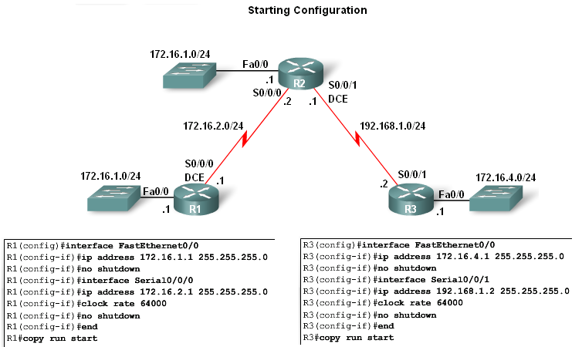
Routing Table Structure
Lab topology
3 router setup:
  R1 and R2 share a common 172.16.0.0/16 network with 172.16.0.0/24 subnets
  R2 and R3 are connected by the 192.168.1.0/24 network
  R3 also has a 172.16.4.0/24 subnet, which is disconnected, or discontiguous, from the 172.16.0.0 network that R1 and R2 share

Slide 5
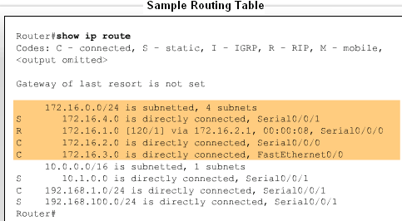
Routing Table Structure
Routing table entries come from the following sources:
  Directly connected networks
  Static routes
  Dynamic routing protocols

Slide 6
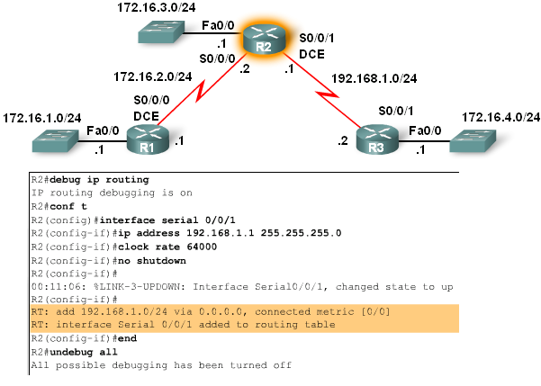
Routing Table Structure
Level 1 routes
As soon as the no shutdown command is issued the route is added to routing table

Slide 7
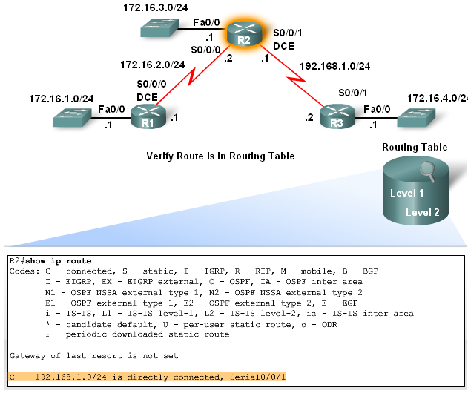
Routing Table Structure
Cisco IP routing table is a hierarchical structure
The reason for this is to speed up lookup process

Slide 8
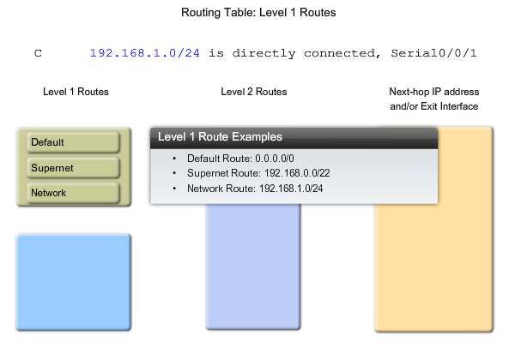
Routing Table Structure
Level 1 routes:
  Have a subnet mask equal to or less than the classful mask of the network address
Level 1 routes can function as:
  Default routes
  Supernet routes
  Network routes

Slide 9
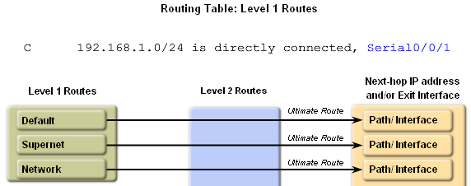
Routing Table Structure
Level 1 routes:
  Ultimate routes includes either:
    A next-hop address
    OR
    An exit interface

Slide 10
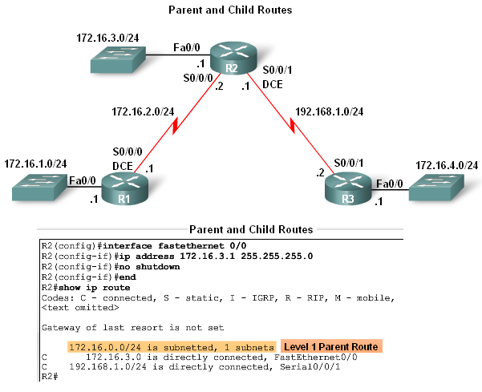
Routing Table Structure
Parent and child routes:
  A parent route is a level 1 route
  A parent route does not contain any next-hop IP address or exit interface information

Slide 11
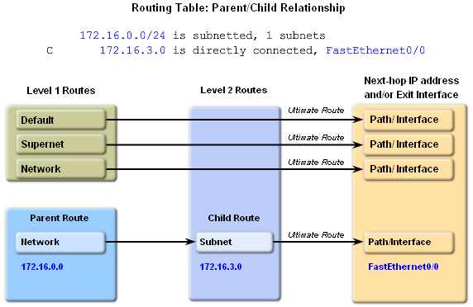
Routing Table Structure
Automatic creation of parent routes:
  Occurs any time a subnet is added to the routing table
Child routes:
  Child routes are level 2 routes
  Child routes are a subnet of a classful network address

Slide 12
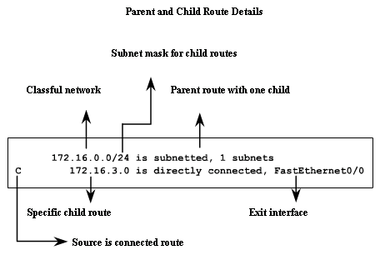
Routing Table Structure
Level 2 child routes contain route source and the network address of the route
Level 2 child routes are also considered ultimate routes
  Reason: they contain the next hop address and/or exit interface

Slide 13
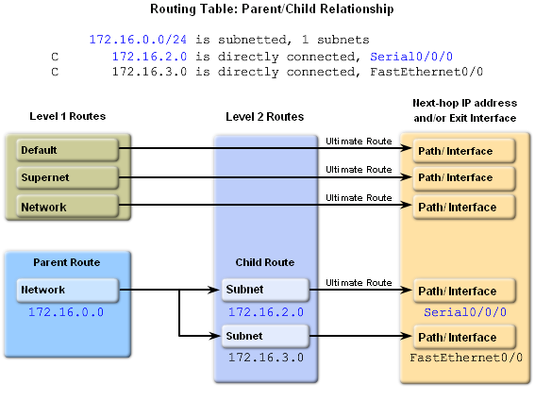
Routing Table Structure
Both child routes have the same subnet mask. This means the parent route maintains the /24 mask

Slide 14
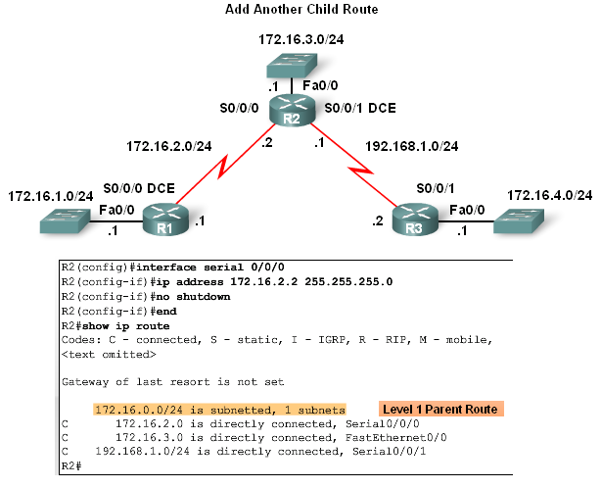
Routing Table Structure
Diagram illustrates 2 child networks belonging to the parent route 172.16.0.0 / 24:

Slide 15
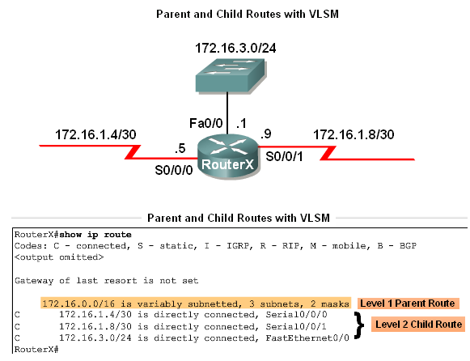
Routing Table Structure
In classless networks, child routes do not have to share the same subnet mask.

Slide 16
Routing Table Structure
Parent & Child Routes: Classless Networks
Network type | Parent route’s classful mask is displayed | Term variably subnetted is seen in parent route in routing table | Includes the # of different masks of child routes | Subnet mask included with each child route entry
Class- ful | No | No | No | No
Class-less | Yes | Yes | Yes | Yes

Slide 17
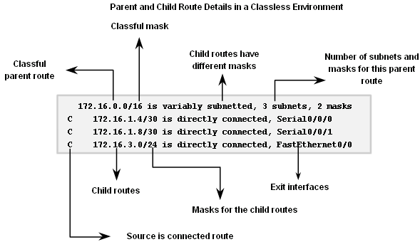
Routing Table Structure
Parent & Child Routes: Classless Networks

Slide 18
Routing Table Lookup Process
The Route Lookup Process
  Examine level 1 routes:
    If best match a level 1 ultimate route and is not a parent route this route is used to forward packet
  Router examines level 2 (child) routes:
    If there is a match with level 2 child route then that subnet is used to forward packet
    If no match then determine routing behavior type
  Router determines classful or classless routing behavior:
    If classful then packet is dropped
    If classless then router searches level one supernet and default routes
    If there exists a level 1 supernet or default route match then Packet is forwarded, if not packet is dropped

Slide 19
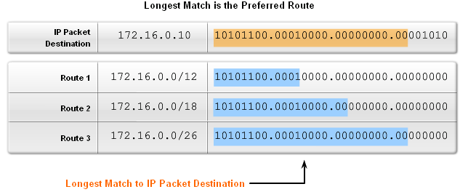
Routing Table Lookup Process
Longest Match: Level 1 Network Routes:
  Best match is also known as the longest match
  The best match is the one that has the most number of left most bits matching between the destination IP address and the route in the routing table

Slide 20
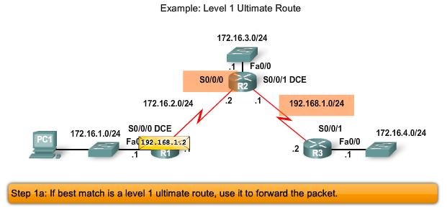
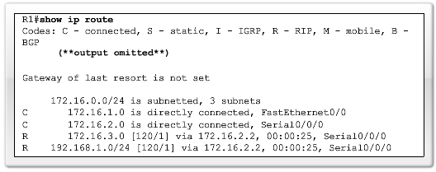
Routing Table Lookup Process
Finding the subnet mask used to determine the longest match
Scenario:
  PC1 pings 192.168.1.2
  Router examines level 1 route for best match
  There exist a match between 192.168.1.2 and 192.168.1.0 / 24
  Router forwards packets out s0/0/0

Slide 21
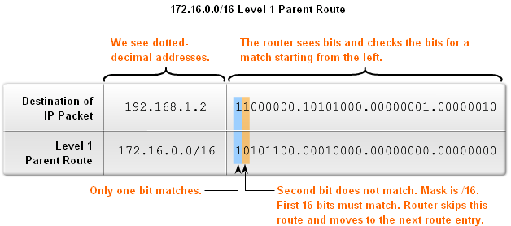
Routing Table Lookup Process
The process of matching:
  1st there must be a match made between the parent route & destination IP
  If a match is made then an attempt at finding a match between the destination IP and the child route is made

Slide 22
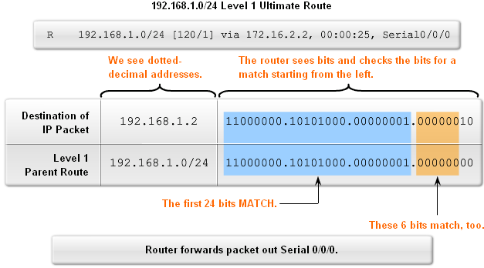
Routing Table Lookup Process
Finding a match between the packet’s destination IP address and the next route in the routing table:
  The figure shows a match between the destination IP of 192.168.1.2 and the level one IP of 192.168.1.0 / 24 then packet forwarded out s0/0/0

Slide 23
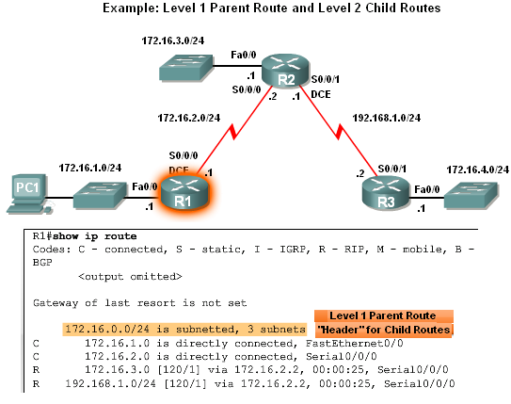
Routing Table Lookup Process
Level 1 Parent & Level 2 Child Routes
Before level 2 child routes are examined
  There must be a match between classful level one parent route and destination IP address

Slide 24
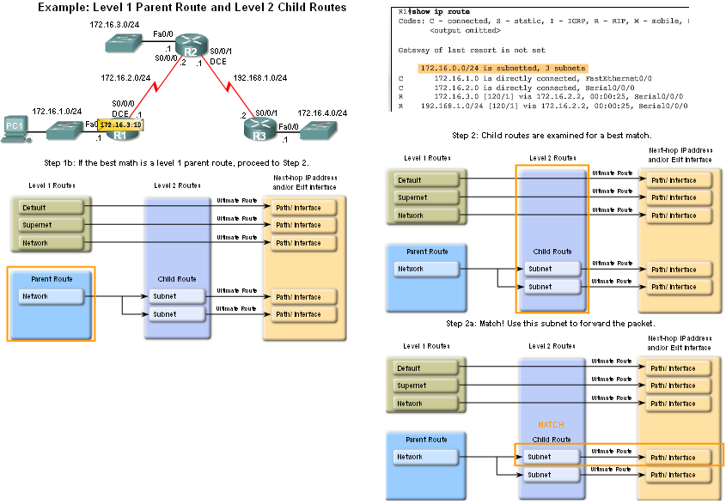
Routing Table Lookup Process
After the match with parent route has been made Level 2 child routes will be examined for a match
  Route lookup process searches for child routes with a match with destination IP

Slide 25
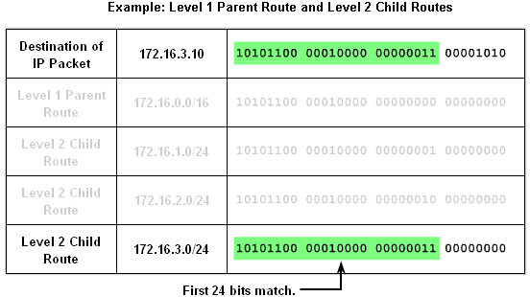
Routing Table Lookup Process
How a router finds a match with one of the level 2 child routes:
  First router examines parent routes for a match. If a match exists then:
    Child routes are examined
    Child route chosen is the one with the longest match

Slide 26
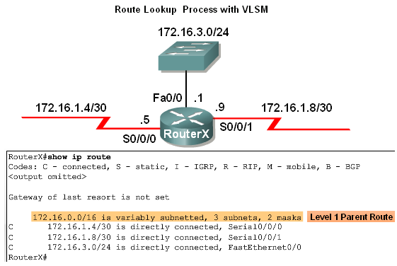
Routing Table Lookup Process
Example – Route Lookup Process with VLSM:
  The use of VLSM does not change the lookup process
  If there is a match between destination IP address and the level 1 parent route then Level 2 child routes will be searched

Slide 27
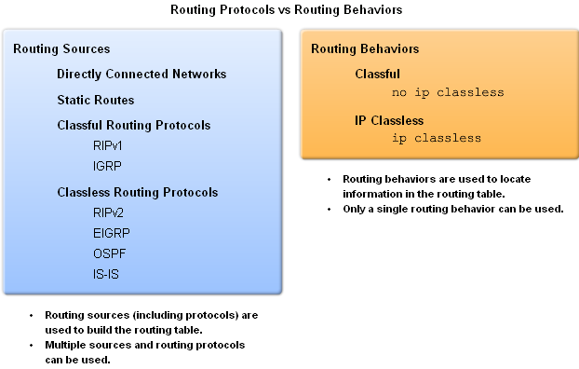
Routing Behavior
Classful & classless routing protocols:
  Influence how routing table is populated
Classful & classless routing behaviors:
  Determines how routing table is searched after it is filled

Slide 28
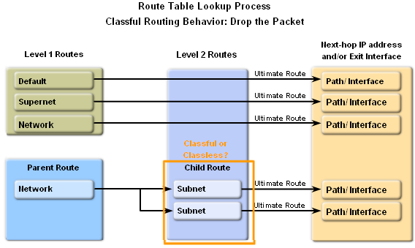
Routing Behavior
Classful Routing Behavior: no ip classless
What happens if there is not a match with any level 2 child routes of the parent?
  Router must determine if the routing behavior is classless or classful
  If router is utilizing classful routing behavior then lookup process is terminated and packet is dropped

Slide 29
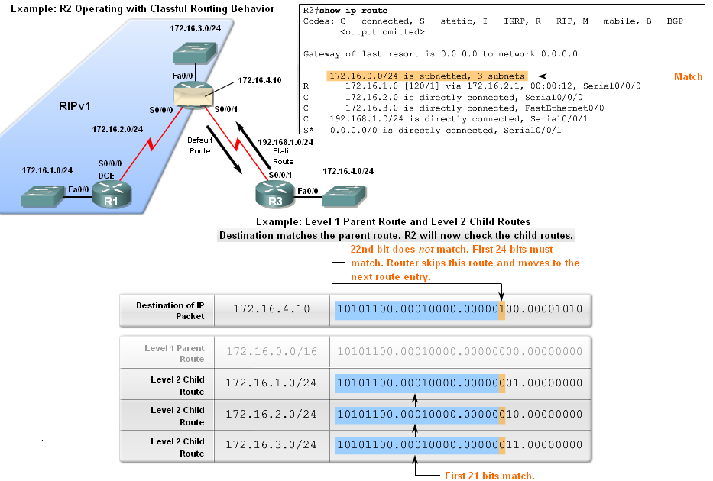
Routing Behavior
Classful Routing Behavior – Search Process
An example of when classful routing behavior is in effect and why the router drops the Packet
  The destination’s subnet mask is a /24 and none of the child routes left most bits match the first 24 bits. This means packet is dropped.

Slide 30
Routing Behavior
Classful Routing Behavior – Search Process
The reason why the router will not search beyond the child routes:
  Originally networks were all classful
  This meant an organization could subnet a major network address and “enlighten” all the organization’s routers about the subnetting
  Therefore, if the subnet was not in the routing table, the subnet did not exist and packet was dropped

Slide 31
Routing Behavior
Classless Routing Behavior: ip classless
Beginning with IOS 11.3, ip classless was configured by default
Classless routing behavior works for:
  Discontiguous networks
    and
  CIDR supernets

Slide 32
Routing Behavior
Classless Routing Behavior: ip classless
Route lookup process when ip classless is in use:
  If classless routing behavior in effect then:
    Search level 1 routes
    Supernet routes checked first
  If a match exists then forward packet
    Default routes checked second
  If there is no match or no default route then the packet is dropped

Slide 33
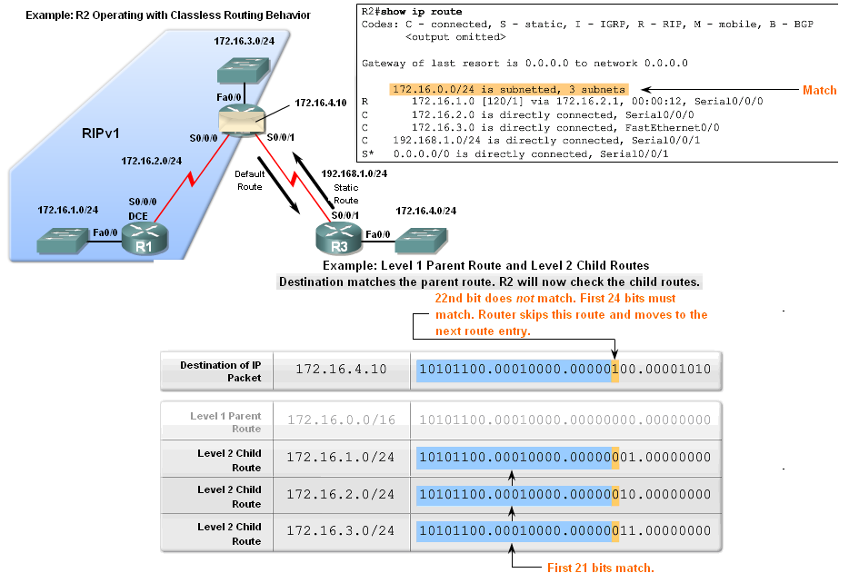
Routing Behavior
Classless Routing Behavior – Search Process
Router begins search process by finding a match between destination IP and parent route
  After finding the above mentioned match, then there is a search of the child route

Slide 34
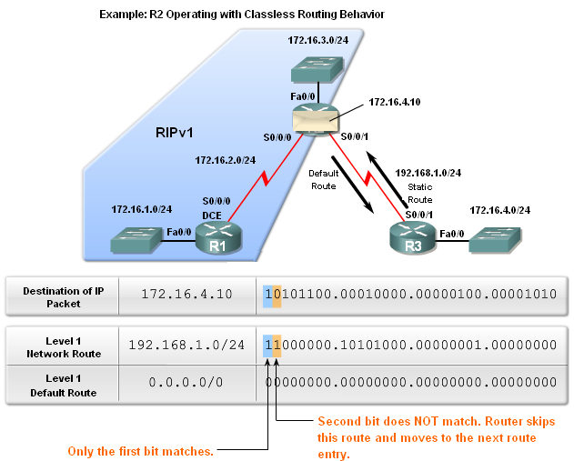
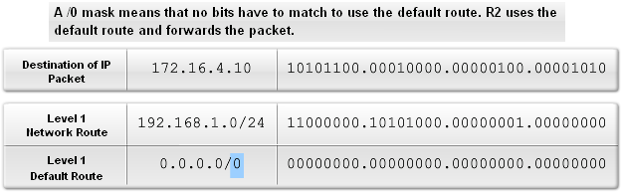
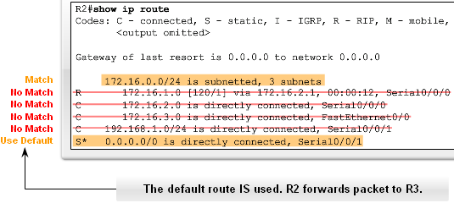
Routing Behavior
Classless Routing Behavior – Search Process
If no match is found in child routes of previous slide then:
  Router continues to search the routing table for a match that may have fewer bits in the match

Slide 35
Routing Behavior
Classful vs. Classless Routing Behavior:
  It is recommended to use classless routing behavior
    Reason: so supernet and default routes can be used whenever needed

Slide 36
Summary
Content / structure of a routing table:
Routing table entries:
  Directly connected networks
  Static route
  Dynamic routing protocols
Routing tables are hierarchical:
  Level 1 route:
    Have a subnet mask that is less than or equal to classful subnet mask for the network address.
  Level 2 route:
    These are subnets of a network address.

Slide 37
Summary
Routing table lookup process:
  Level 1 route examination:
    Begins with examining level 1 routes for best match with packet’s destination IP. If the best match equals an ultimate route then packet is forwarded, or else…
    Parent route is examined. If parent route & destination IP match then Level 2 (child) routes are examined.
  Level 2 route examination:
    If a match between destination IP and child route found then packet forwarded, or else…
    If Router is using classful routing behavior then packet is dropped, or else…
    If router is using classless routing behavior then router searches Level 1 supernet and default routes for a match. If a match is found then Packet is forwarded, or else…
    Packet is dropped.

Slide 38
Summary
Routing behaviors:
  This refers to how a routing table is searched.
Classful routing behavior:
  Indicated by the use of the no ip classless command.
  Router will not look beyond child routes for a lesser match.
Classless routing behavior:
  Indicated by the use of the ip classless command.
  Router will look beyond child routes for a lesser match.

